Slide 1
A Famous Tort Law Case: A frivolous lawsuit?

Slide 2
Overview
Important vocabulary
Facts of the case
Stakeholders
Benefit/harm analysis
Rights/duties/values
Options
Discussion

Slide 3
1. tort | a civil wrong
2. frivolous | not having any serious purpose or value
3. lawsuit | proceeding by a party or parties against another in a court
4. to sue someone | to accuse someone (in court) of doing something wrong or illegal and demand that they pay for it
5. liability | the state of being legally responsible for something
6. litigation | an action brought in court to enforce a particular right
7. duty of care | a legal obligation which is imposed on an individual requiring adherence to a standard of reasonable care while performing any acts that could foreseeably harm others
8. claimant | party making a formal demand for a payment or asserting a right (der Kläger)
9. defendant | the party against whom relief or recovery is sought in a lawsuit
10. negligence | a failure to exercise the care that a reasonably prudent person would exercise in like circumstances. The area of tort law known as negligence involves harm caused by carelessness, not intentional harm
11. damages | a sum of money claimed or awarded in compensation for a loss or an injury
12. punitive | intended as punishment

Slide 4
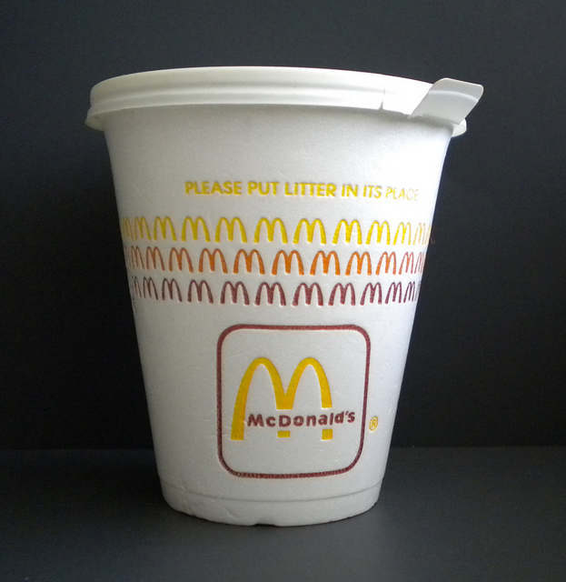

Slide 5
Liebeck v. McDonald's Restaurants
Aka “The McDonald's Coffee Case“ and “The Hot Coffee Lawsuit“
This 1994 product liability lawsuit is for some people an example of frivolous litigation, even "the poster child of excessive lawsuits“ (NBC)

Slide 6
The Facts
In 1992, Stella Liebeck, a 79-year-old woman from Albuquerque, New Mexico, bought a cup of coffee from the drive-through of a McDonald’s restaurant.
Liebeck placed the coffee cup between her legs and opened it. She spilled the entire cup of coffee on her lap. Liebeck was wearing cotton sweatpants which held the hot liquid against her skin, burning her lower body severely.
At the hospital, it was determined that she had suffered third-degree burns on six per cent of her skin. She stayed in the hospital for eight days.

Slide 7
Some more facts...
During the trial, it emerged that:
McDonalds served their coffee at 180-190 degrees fahrenheit (= 82-87 C), which is hot enough to give 3rd degree burns in 2-7 seconds.
In 10 years there had been over 700 reports of people burnt by the coffee to varying degrees of severity.
The Health Department had warned McDonalds to lower the temperature of their coffee before, but they had not.

Slide 8
Who are the Stakeholders?
The injured woman and her family
MacDonald‘s Corporation
Other customers
Other fast-food restaurants

Slide 9
Who benefitted or was harmed from/by the sale of take away coffee that was too hot?
Those who benefitted
Those who were harmed
MacDonald‘s
Customers who wanted very hot coffee
In the long run:
The lawyers
Future customers
The injured woman
Other customers who were not aware of the temperature
In the long run:
The legal system (?)

Slide 10
What rights, duties, values are involved?
Consumers‘ have the right not to be harmed by a product BUT they are also responsible for their own actions
Companies have a duty of care
Core question:
Where is the line between product liability and personal responsibility?

Slide 11
What choices or options are faced by the stakeholders?
Claimant could drop the claim
Defendant and claimant could agree to settle out of court
Before the case:
Defendant could have added warnings or reduced temperature after first injuries had occurred

Slide 12
Procedural history (= history of the case in court)
After several attempts to reach a settlement failed, the claimant sued the defendant for gross negligence.
The jury found for the claimant, determining that the defendant was 80% responsible and the claimant 20%.
The claimant was awarded $200,000 in compensatory damages, which was then reduced by 20% to $160,000. $2.7 million in punitive damages were also awarded.

Slide 13
Procedural history, cont.
... These damages were then reduced to $480,000.
The decision was appealed by both claimant and defendant. However, an out-of-court settlement for less than $600,000 was finally reached.

Slide 14
What do you think? Which of these statements do you agree with?
The case was not frivolous, it was a “meaningful and worthy lawsuit“.
The lawsuit was frivolous – “the equivalent of suing a company that makes hammers because someone accidently hit his thumb and broke it while hammering“.

